Slide 1

Capability Brief For: Robert Chang, Denis Leverson AASKI Technology Inc
8 (a) Certified Small Business
CMMI Maturity Level 3 Certified
12950 Worldgate Drive, Suite #230
Herndon, VA 20170
www.technikinc.com
September 17, 2015

Slide 2

Overview
Technik has developed and institutionalized processes, procedures, templates and checklists designed to develop, maintain, and support IT Applications. Our team has outstanding qualifications and experience to perform a broad range of support for Federal Government
agencies.
Technik provides software and system support to various agencies. We believe in building long term
relationships with our
customers, founded on the principal that full and open communication benefits all parties. .
Corporate Capability
Program Familiarity & Customer Relationships
Company Qualifications
Past Performance
We have modernized mission essential systems for the Securities and Exchange Commission (SEC), developed Innovative solutions at Veterans Affairs (VA), and operated and maintained the WAN for VA Office of Research and Development (VA ORD).
CMMI Maturity Level 3 for Development (DEV) v1.3
CMMI Maturity Level 3 Services (SVC) v1.3
ISO 9001:2008 – ANSI/ISO/ ASQ Q9001 – 2008
Currently supporting 6 Federal agencies with Information Technology (IT) related tasks.
DSS Secret cleared corporation
30+ IT consulting and delivery projects successfully executed since inception of the company
Two (2) US office locations
Successfully overseen major application development initiatives for multiple Federal agencies
Demonstrated history of outstanding government contract performance of a similar size and scope
1 Overview 2 Capabilities 3 Past Performance 4 In Summary

Slide 3
Corporate capabilities
At NASA and USDA we leverage tools such as SPLUNK to ensure the operational integrity, availability, and security of all systems by constantly monitoring system states and activities to proactively identify system anomalies prior to customers being affected.
Developed backend data points to expose data as JSON objects
Implement REST and SOAP interfaces to invoke data components
Developed Single Page Applications using JSON REST API
Multiple contracts, at USDA, SEC and NASA KSC.
Enhance Data Center operations by Virtualizing systems and applications as appropriate
Utilize cloud services where possible
Optimize efficiencies through data center and field operations consolidation.
Utilize pre-defined methods, templates, and operating procedures.
Database Administration
SOA App
Development
Data Center Support
Technik
Demonstrated Capability
Helpdesk
Support
Application Support
Our Army WDTC help desk provides a Single point of contact for incident, problem and change management; supports unified, standardized and consistent processes resulting in improved first-call resolution,
Provide high-productivity Flexible Agile Development Services
Participate in a team-based Agile environment - working alongside other teams of government contractors and federal employees
1 Overview 2 Capabilities 3 Past Performance 4 In Summary
Notes:
Why Technik?
Exceptional PWS capabilities and proven IT past performance
Forward thinking (cloud solutions, integrated IT solutions)
CMMI/ISO/ITIL certifications
App Dev Experience
Proven process improvement
Strong financial stability
Audited business systems in place

Slide 4

Past Performance Kennedy Space Center (KSC) Information Technology Support Services (ITSS)
Enterprise
Architecture
IT Security
Services
Systems
Engineering
Program
Management
Software
Development
& Maint
“This contractor's exceptional performance was
demonstrated in their daily support to the KSC Information Technology and Communications Directorate. Given what I know today about the Contractor's ability to execute what they promised in their proposal, I definitely would award to them today given that I had a choice.”
Contracting Officer, NASA KSC
Contract Value: $19,000,000
Period of Performance: 2/28/2013 – 10/30/2015
Technologies implemented: Maximo, PHP, Hadoop,
SQL Database, Virtual Hyper V, Visual Studio, Java,
J2EE, C++, C#, Python, Apache, ETL
Database Administration | System Administration | Application Support | Logistics / Supply | Website / SharePoint | Data / Operation Center Support | Helpdesk Support | Documentation / Reporting | Program Management
√ | √ | √ | √ | √ | √ | √ | √ | √
1 Overview 2 Capabilities 3 Past Performance 4 In Summary

Slide 5
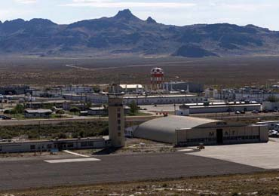
Past Performance US Army, West Desert Test Center (WDTC)
Enterprise
Architecture
Tier 1, 2, 3
Operations
Center
Workstation
Maintenance
Program
Management
COTS
GOTS
Maintenance
Development
Modernization
Enhancement
Direct Test
Support
“Technik personnel consistently demonstrate strict adherence to contractual requirements, established procedures, close attention to detail in the performance of their duties, and the willingness to go beyond the minimums required and do whatever it takes to get the job done. This is evident in all areas of the contract, and the Chief Executive Office (CEO) to the lowest level of workforce”
Contracting Officer, Mission and Installation Contracting CMD
Period of Performance: 2/7/2014 – 8/5/2016
Contract Value: $9,750,072.24
Technologies implemented: JAVA, ASP.NET,
PV-Wave, Visual Numerics, J-Wave
Database Administration | System Administration | Application Support | Logistics / Supply | Website / SharePoint | Data / Operation Center Support | Helpdesk Support | Documentation / Reporting | Program Management
√ | √ | √ | √ | √ | √ | √ | √ | √
1 Overview 2 Capabilities 3 Past Performance 4 In Summary

Slide 6

Past Performance US Department of Agriculture (USDA)
Enterprise
Architecture
Cloud
Integration
Requirements
Management
Program
Management
Information
Assurance
Development
Modernization
Enhancement
Electronic
Commerce
“Technik has earned the business through its continued success on the projects it has completed as well as its care and interest. Technik brings only quality personnel to the table and constantly achieves what the government has contracted. Given what I know today about the Contractor's ability to execute, I definitely would award to them today given that I had a choice.”
Director Software Delivery, USDA APHIS, VS
Period of Performance: 9/30/2008 – 5/12/2017
Contract Value: $4,765,791.34
Technologies implemented: SSRS, SSIS, CRM,
Rational, J2EE, Java, jQuerty, Spring, SharePoint
Database Administration | System Administration | Application Support | Logistics / Supply | Website / SharePoint | Data / Operation Center Support | Helpdesk Support | Documentation / Reporting | Program Management
√ | √ | √ |  | √ |  | √ | √ | √
1 Overview 2 Capabilities 3 Past Performance 4 In Summary

Slide 7

Past Performance United States Citizenship and Immigration Services (USCIS)
Flexible Agile
Development
(FADS)
DevOps
Daily Scrum
Meetings
Program
Management
Kanban
Boards
“The teams are full of incredibly talented, dedicated and innovative thinkers. They strive to put their best foot forward every day and deliver high business value functionality in every sprint.”
David A. Blair, Release Manager | Chief, Release Management Branch USCIS Office of Transformation Coordination Department of Homeland Security
Period of Performance: 3/1/2014 – 2/28/2015
Contract Value: $6,232,281.00
Technologies implemented: Rally, Angular JS, Java/J2EE, Git, Liquibase, Gradle, Jenkins, Oracle /MongoDB, Jboss
Database Administration | System Administration | Application Support | Logistics / Supply | Website / SharePoint | Data / Operation Center Support | Helpdesk Support | Documentation / Reporting | Program Management
√ | √ | √ |  | √ |  |  | √ | √
1 Overview 2 Capabilities 3 Past Performance 4 In Summary

Slide 8
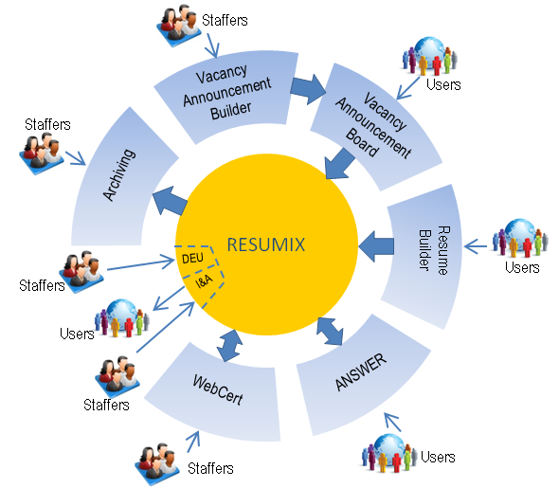

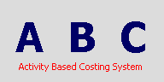


Past Performance Department of Army, AG-1 (CPP)
Design
And Analysis
Requirements
Analysis
Software
Development
Program
Management
System
Testing
Development
Modernization
Enhancement
Customer
Support
Period of Performance: 2006 - 2011
Contract Value: $3,987,000.00
Technologies implemented: J2EE, HTML, XML, .NET,
“…Your leadership ability and your exceptional technical and analytical skills have provided our organization with numerous successes”
Secretary of Army, Manpower and Reserve Affairs AG-1 CP
Database Administration | System Administration | Application Support | Logistics / Supply | Website / SharePoint | Data / Operation Center Support | Helpdesk Support | Documentation / Reporting | Program Management
√ | √ | √ | √ | √ | √ | √ | √ | √
1 Overview 2 Capabilities 3 Past Performance 4 In Summary

Slide 9
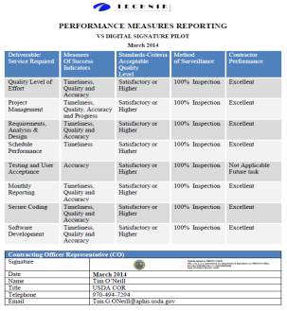
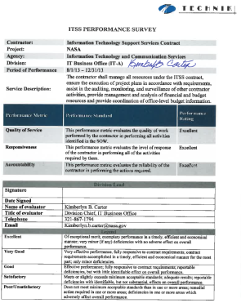
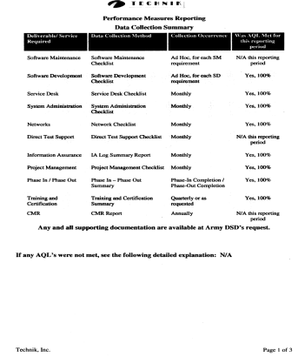
Metrics based evaluations
Proven software development organizational processes based upon the principles of CMMI Maturity Level 3 Certification
ISO 9001:2000 Registered Quality Control and Assurance processes
32 Consecutive A++ perfect score performance evaluations on O&M and DME contracts
A deep and comprehensive understanding of the ARMY environment and the history, status, and objectives of the USDA APHIS programs.
Corporate and project leadership which are PMP certified, EA Certified, GIAC certified, Microsoft certified Professionals, and Sun Certified Java Programmers and Architects
1 Overview 2 Capabilities 3 Past Performance 4 In Summary

Slide 10
In Summary
Database Administration
SOA
Development
Data Center Support
Proven
Capabilities
Helpdesk
Support
Application Support
Alexa Tsui
Technik, Inc. VP, Business Development
Industry Certifications
Anand Murthy
President
CMMI ML3 for Development (DEV/SVC)
ISO 9001:2008
Office: 703.953.1577
Cell: 571.438.5093
alexa.tsui@technikinc.com
Program Familiarity
Office: 703.953.1512
Cell: 703.615.4946
Anand.murthy@technikinc.com
Overseen major Army initiatives such as the development and deployment of the Army Staffing Suite and the Civilian Personnel Online (CPOL) knowledge portal.
Why Technik?
Exceptional PWS capabilities
Proven IT past performance
Forward thinking (cloud solutions, integrated IT solutions)
1 Overview 2 Capabilities 3 Past Performance 4 In Summary
Notes:
Why Team VTS?
Exceptional PWS capabilities and proven IT past performance
Forward thinking (cloud solutions, integrated IT solutions)
CMMI/ISO/ITIL certifications
MITS incumbency (MITS end user familiarity)
MSFC, KSC and JSC Center experience
Knowledge /understanding of NASA culture
Proven process improvement
Experienced Program Manager
Strong financial stability
Knowledge of other MSFC contracts
Successful Phase-in Experience at MSFC and other NASA centers
Audited business systems in place
Experience in implementing Joint Ventures

Slide 11






Customer Testimonials
“Your services contribute to our program's success and ultimately help the VA provide better health care for Veterans. Working with you on the project it was clear you cared about the quality of your work, how it benefited the Veteran, and you weren't afraid of a few road bumps -- it really showed in your work.”
VHA Innovations Coordinator Department of Veteran Affairs
“… Working with a team that is as intent on satisfying the customer by bringing in expert and professional employee’s that are single focused on in budget and on time project completion is a quality lacking in many organizations today but not yours. The project managers, system analysts and developers that your organization provide us were superb to say the least. The expertise they brought was beneficial in the successful deployment and use of the VSPS application. This success will allow Veterinary Services to trace animal disease and continue to protect the American public for years to come. Any organization (public or private sector) that engages your company for contract work is going to find a company that is capable of working across multifunctional and diverse groups to find and resolve their needs. I would highly recommend Technik, Inc. to any organization wanting to produce an IT project successfully.”
Director, Software Services & Delivery US Department of Agriculture, APHIS
“As we have come to the close of our VA Innovations Project for the Daily Plan we would like to take this opportunity to thank you for all of your efforts in helping us to develop this project into an outstanding product. You were instrumental in providing us with the support that we needed to be able to take our vision and turn it into a viable, workable tool that others in the VA may be able to use in the future to provide our Veteran patients with Safe Patient Care. The time and energy that you put forth to make this project successful is evidence of your compassion to our Nation’s Veterans. Please accept our sincere gratitude and know that your efforts are certainly appreciated.”
Program Manager, Department of Veteran Affairs
“I would like to commend you for your contributions to this organization. Your leadership ability and your exceptional technical and analytical skills have provided our organization with numerous successes”
Office of the Assistant Secretary of Army, Manpower and Reserve Affairs

